Slide 1

NBA Playoff Predictive Modeling
By Dean Roeser, Jack Hilvert, and Riley Halloran
Notes:
Dean

Slide 2

A Brief Introduction to the NBA
30 Teams
2 Conferences of 15 Teams
82 Game Season
Top 8 Teams of each division make the playoffs
Notes:
Dean

Slide 3
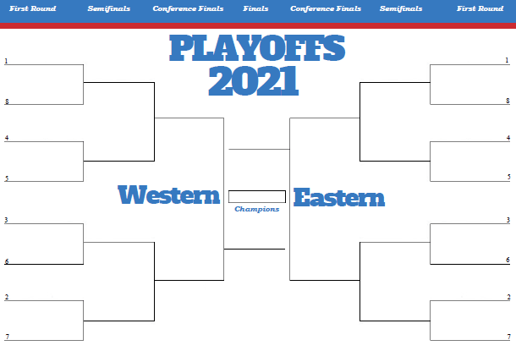
NBA Playoffs
16 Teams
4 rounds
Best of 7
A teams placement is based on regular season record
The finals are always one team from the West against one from the East
Notes:
Dean

Slide 4
Data Mining Pipeline
Want to determine the post season champion from regular season data
Our data is taken from the NBA website
Using a Decision Tree to classify the champion
Trained against the past 10 years and tested against the actual championship
Looked at the results and adjusted accordingly
Notes:
Riley

Slide 5
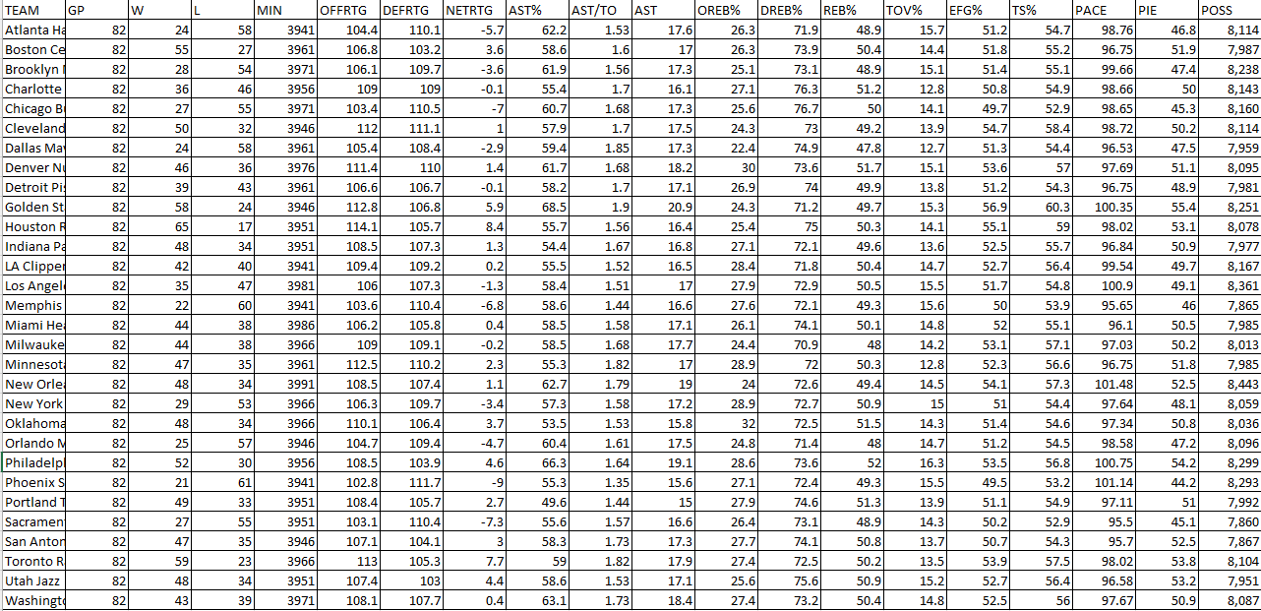
Our Data Set
NBA Stats website is sorted by year and regular season or post
Uses many statistics like offrtg and tov%
Problems:
Team names change
# of regular season games changes
# of teams change
Notes:
Riley

Slide 6
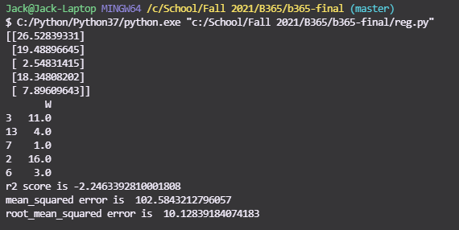
Our Model - Regression
Started trying to use regression
Hoped to get a value that determines all the teams postseason wins
Results were not desirable:
R2 Error = -2.246
A measure of variance
Mean Error = 102.58
Root Mean Square Error = 10.128
Notes:
Riley

Slide 7
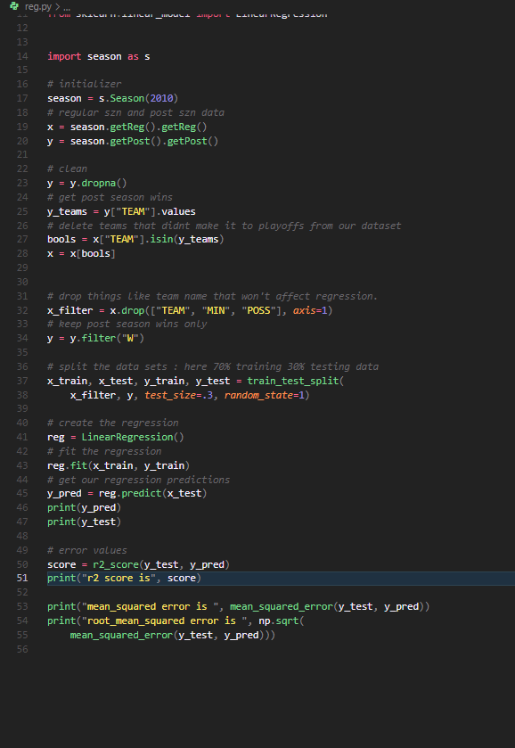
Regression
Notes:
Riley

Slide 8
Our Model - Decision Trees
Changed our project to determine end of season champion
We accomplished this by using decision tree to classify amount of playoff wins and see who had the most.
How we trained:
First: 2010 to predict 2011
Second: all seasons to predict the most recent
Finally: use all previous seasons to predict most recent, but make Sure to have at least 10 seasons prior to the prediction.
Notes:
Jack

Slide 9
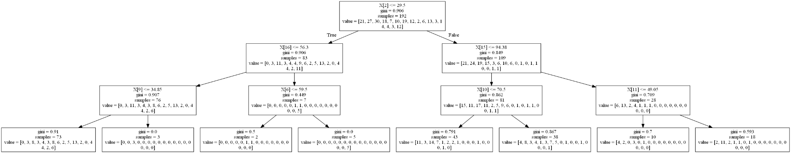
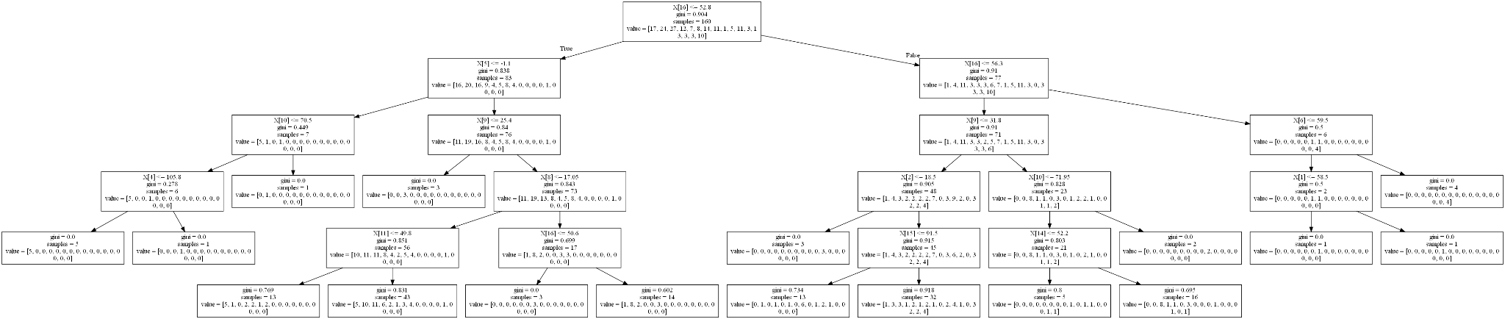
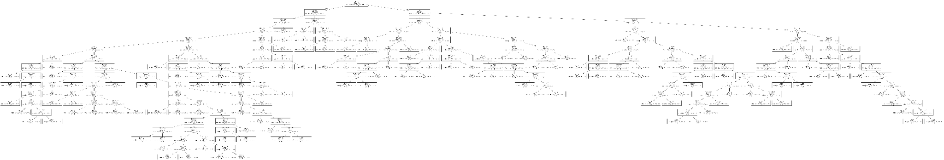
Limiting depth of tree (n=3, n = 5, no limit)
Notes:
Jack

Slide 10
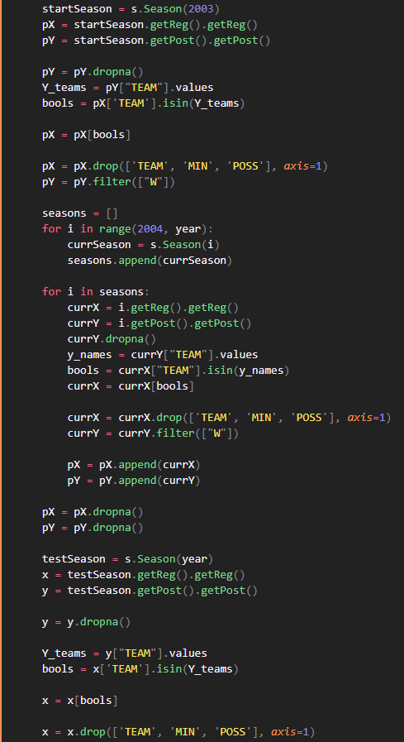
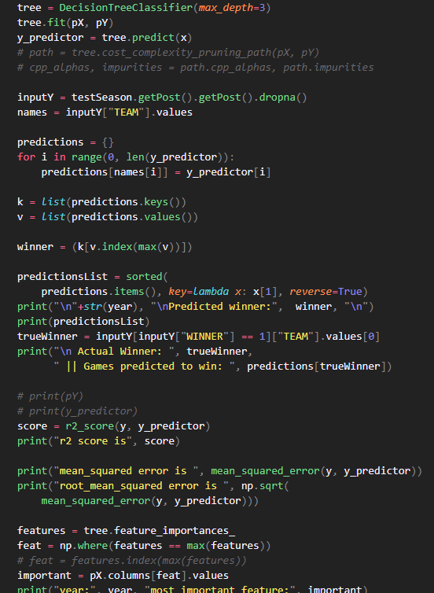
Tree and output
Cleaning and collecting
Notes:
Jack

Slide 11
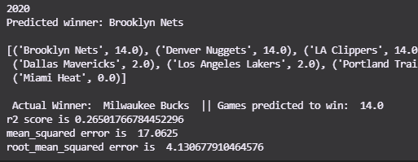
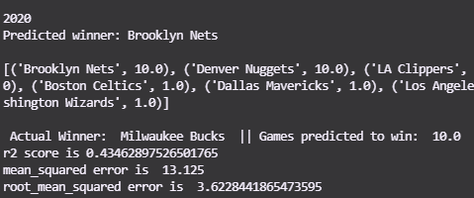
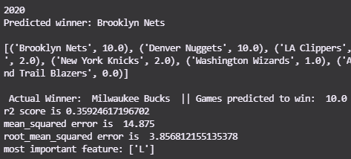
Results of limiting the tree
Saw a decrease in error by limiting the depth of the tree
Depth = 5
Err = 14.875
Depth = 3
mean^2 err = 13.12
No limit
mean^2 err = 17.06
Notes:
Jack

Slide 12
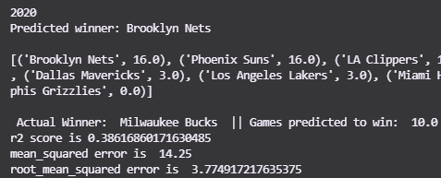
Our Model: Random Forest
Decided to try out a random forest model after successfully generating our decision tree
Results were not significantly better than the limited tree.
Metrics:
Mean squared error = 14.25
Root_mean_err = 3.775
Notes:
Jack

Slide 13
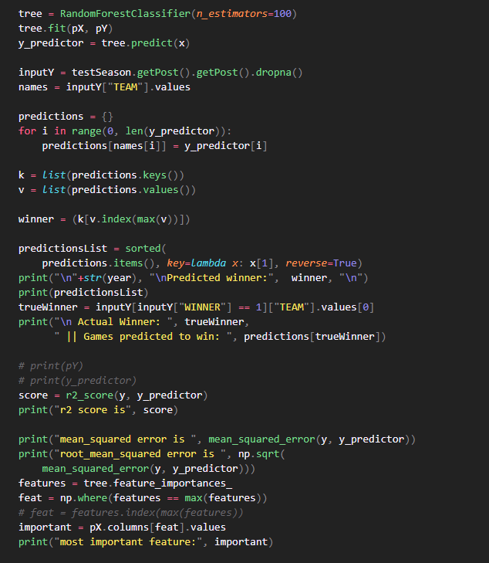
Forest and Output
Notes:
Jack

Slide 14
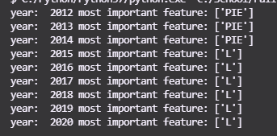
Most important features
Changes depending on what year we look at
Most commonly:
Number of losses
PIE - player impact estimate
What % of game events did that Player or team participate in
Notes:
Jack

Slide 15
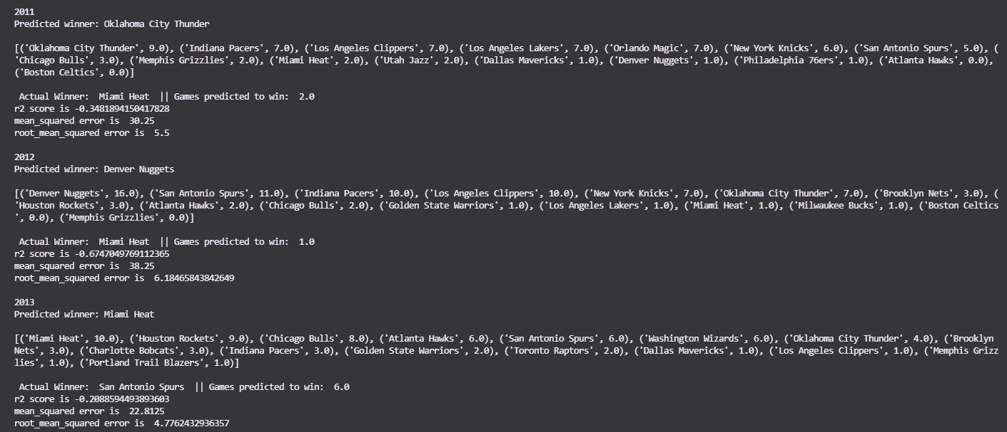
Our Results
Good Things:
Does a good job of placing the winner somewhere in the top 2
Bad Things:
Does Not take into account anecdotal data (who played, was it an upset)
Does not use conferences as a determiner
Notes:
Dean

Slide 16
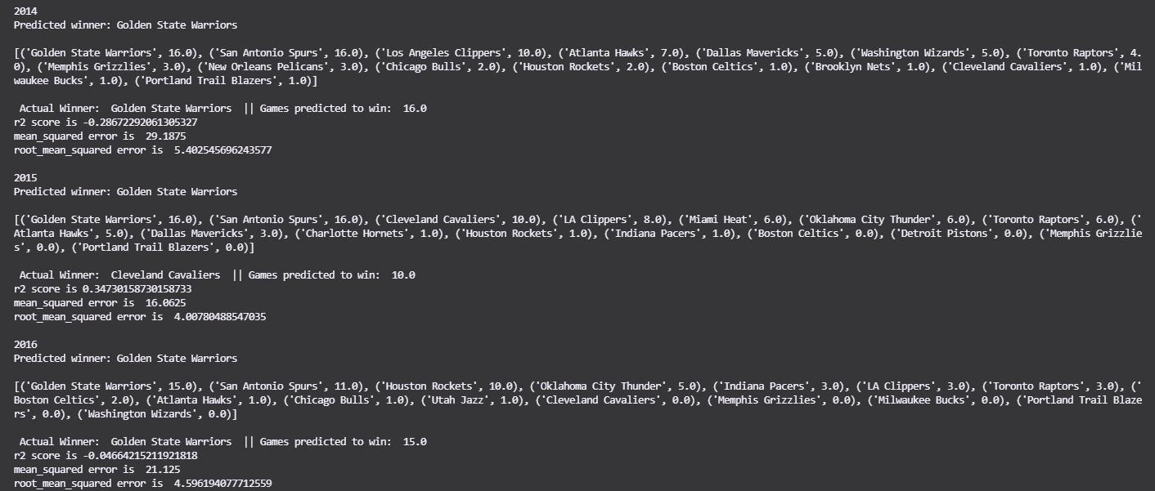
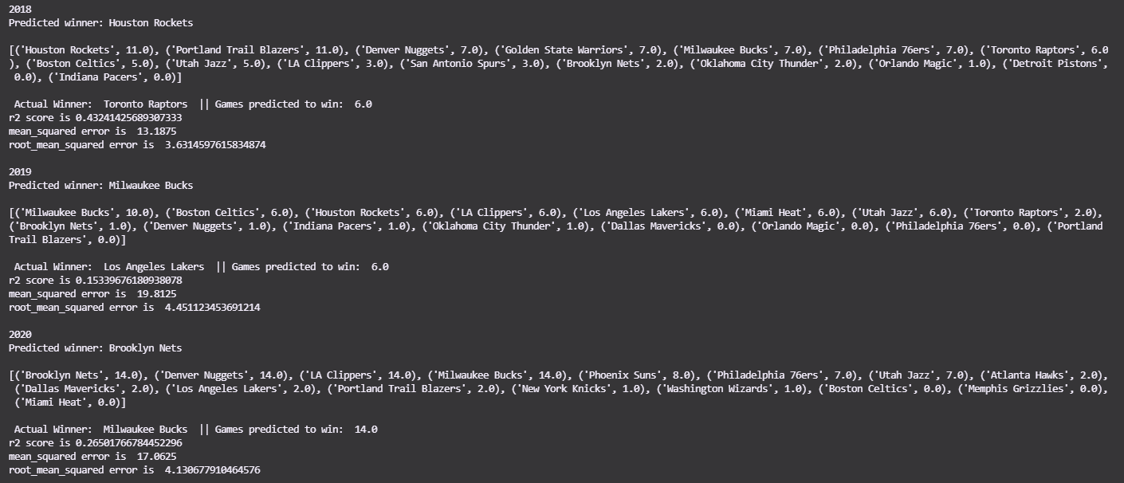
Our Results

Slide 17


Our Best Predictions
2011-2012
Notes:
Dean

Slide 18


Our Best Predictions
2014-2018
Notes:
Dean

Slide 19


Our Best Predictions
2020-2021
Notes:
Dean

Slide 20
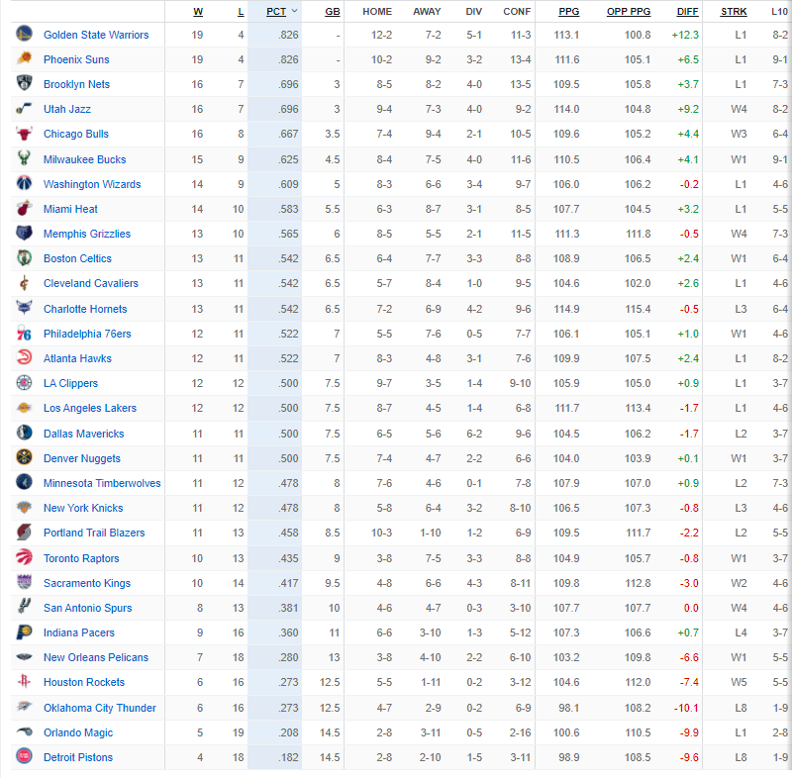
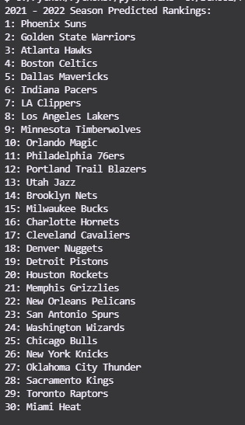
Predicting this Year
Notes:
Dean

Slide 21
Conclusions
Predicting sports is hard and complicated - never 100% accurate
Stats do help you get a better understanding and prediction for sports
Notes:
Riley

